Slide 3
INITIALS

Slide 4
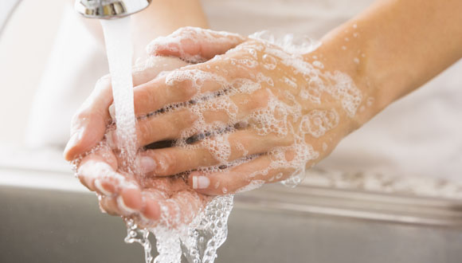
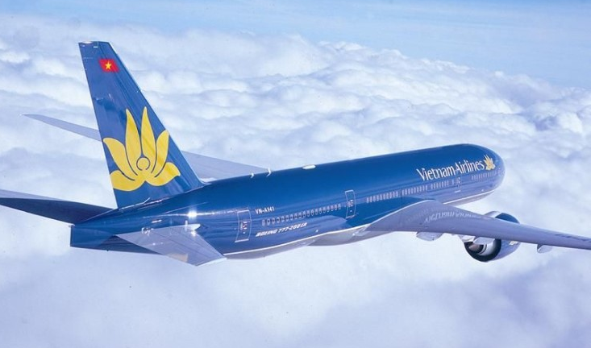
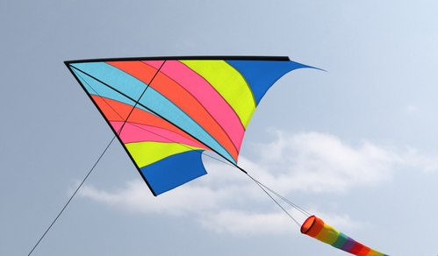
RULE
Take the first letters from each picture and form the mystery word!
WASH
AIRPLANE
LEG
KITE
W A L K

Slide 5
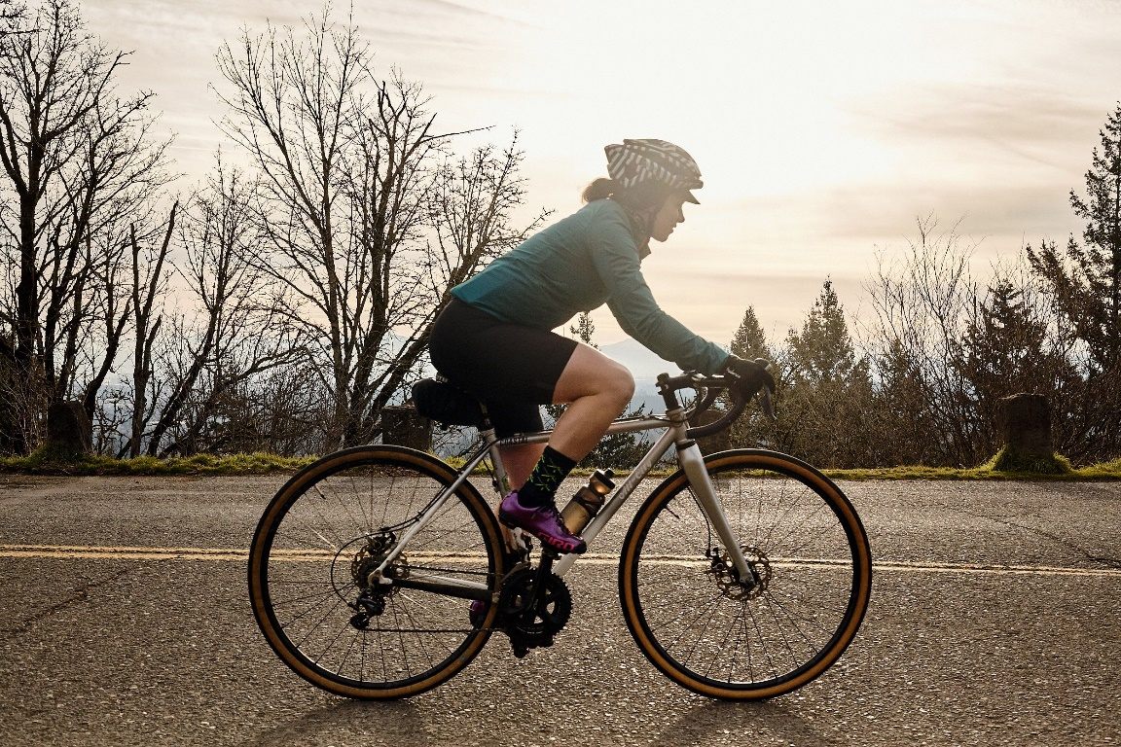
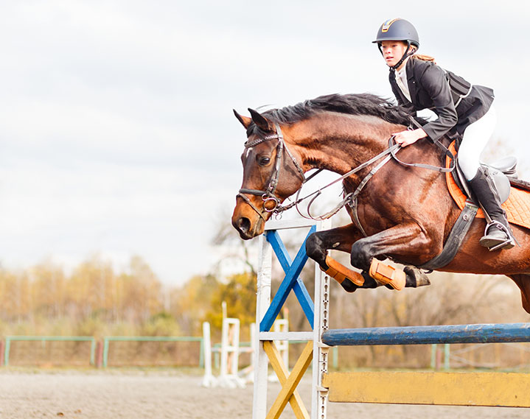
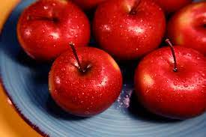
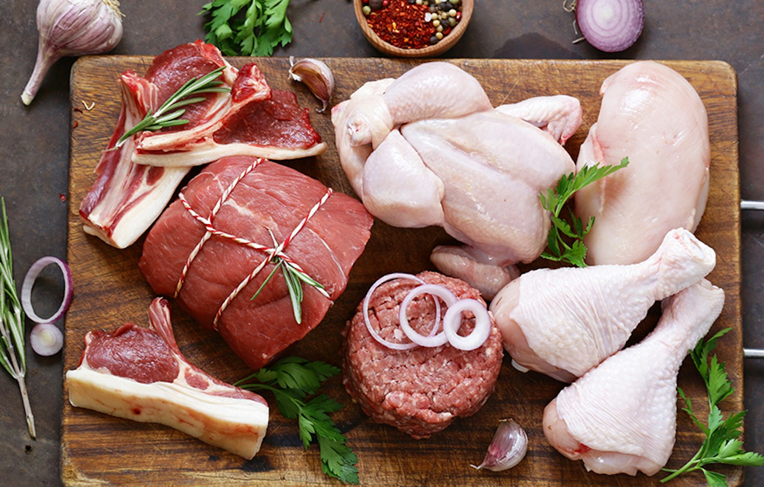
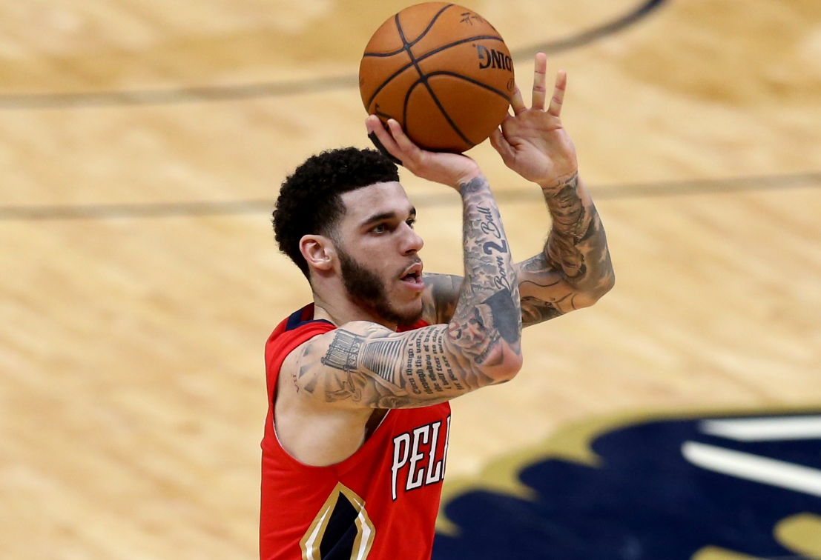
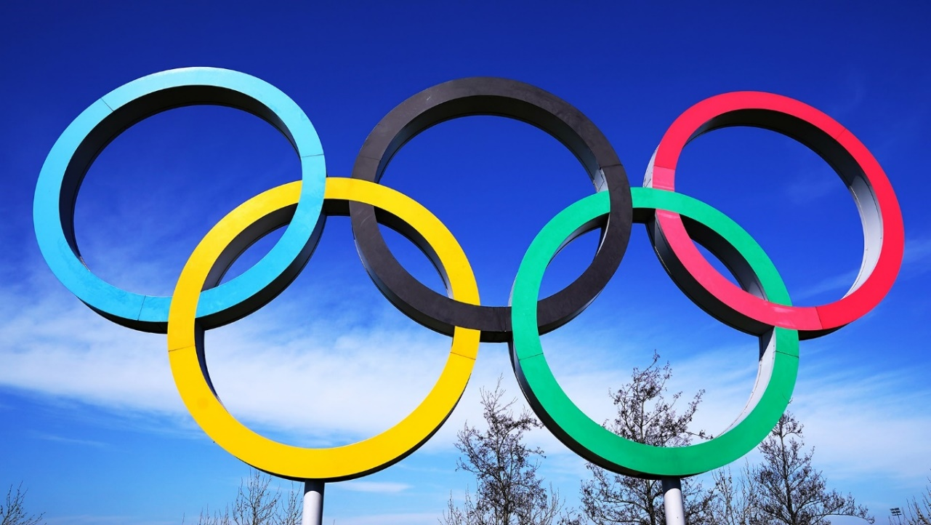
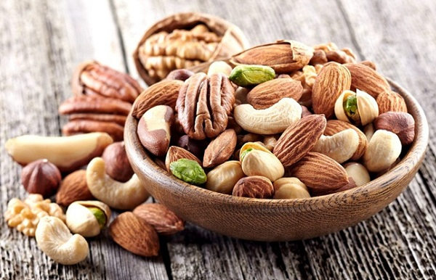
CYCLING
HORSE-RIDING
APPLE
MEAT
PLAYER
IN
OLYMPIC
NUTS

Slide 6
C H A M P I O N

Slide 7
UNIT 6: SPORTS
Lesson 2
READING

Slide 8
1. When and where are the next Olympic Games?
2. Which sport in the box is NOT in the Olympics?

Slide 9
Activity 1:
swimming, marathon / running, golf, rugby

Slide 10
Activity 2:
1. False
(There were only silver and bronze medals.)
2. True
(She was from Denmark.)
3. False
4. True
(They were Olympic sports for the first time in 2016.)
5. False

Slide 11
Activity 3:
1. winner (n)
/ˈwɪn.ɚ/

Slide 12
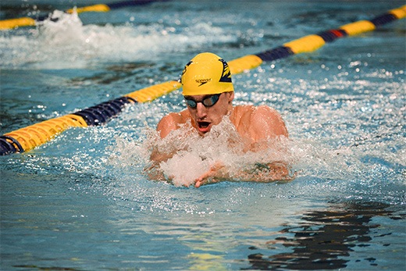
2. swimmer (n)
/ˈswɪm·ər/

Slide 13
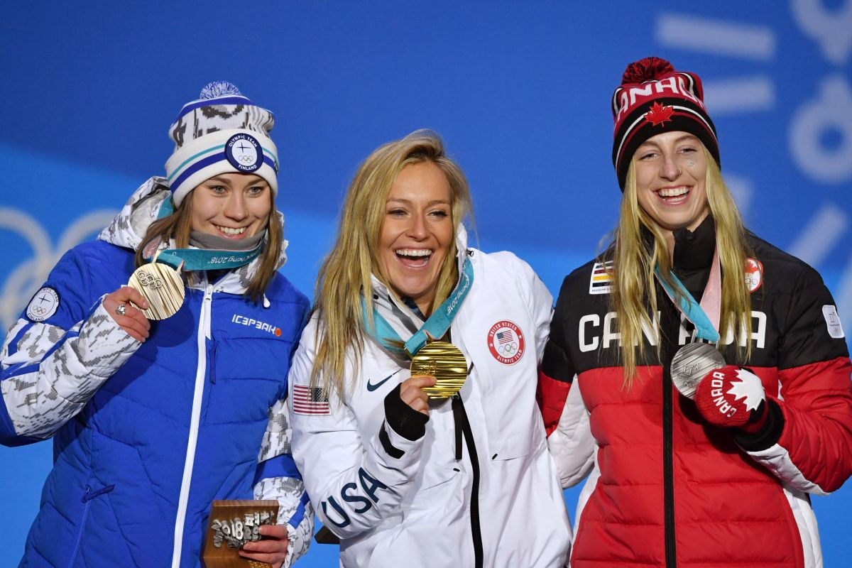
3. medallist (n)
/ˈmed.əl.ɪst/

Slide 14
Activity 3 - Words in blue:
1. winner (n) /ˈwɪn.ɚ/
2. swimmer (n) /ˈswɪm·ər/
3. medallist (n) /ˈmed.əl.ɪst/

Slide 15
Complete the sentences with the blue words
from the text.
1. A ______________ wins a competition.
2. A ______________wins a medal.
3. A ______________swims.
winner
medallist
swimmer

Slide 17
Activity 4:
Speaking

Slide 18
Which piece of information in the text do you think is the most interesting?
What sports do you like watching in the Olympics?

Slide 19
HOMEWORK
Learn by heart all the new words.
Workbook: page 46.
Prepare Lesson 3 – LANGUAGE FOCUS.

Slide 20
www.phuongnam.edu.vn

Slide 21
Thank you!
CTCP ĐẦU TƯ VÀ PHÁT TRIỂN GIÁO DỤC PHƯƠNG NAM

